Slide 1
Autonomous Intersection Management
Ahmed Fayed & Alex Winger

Slide 2
Project Scope & Completion
4-way 3-dedicated-lane intersection with a centralized architecture and minimum V2V communication.
No communication failure, delay, or execution error
We are using ROS and RViz for visualization.
Update:
Visualization with RViz done
More advanced Adaptive Cruise Control (ACC) developed
Different System modes (including our improved policy)

Slide 3
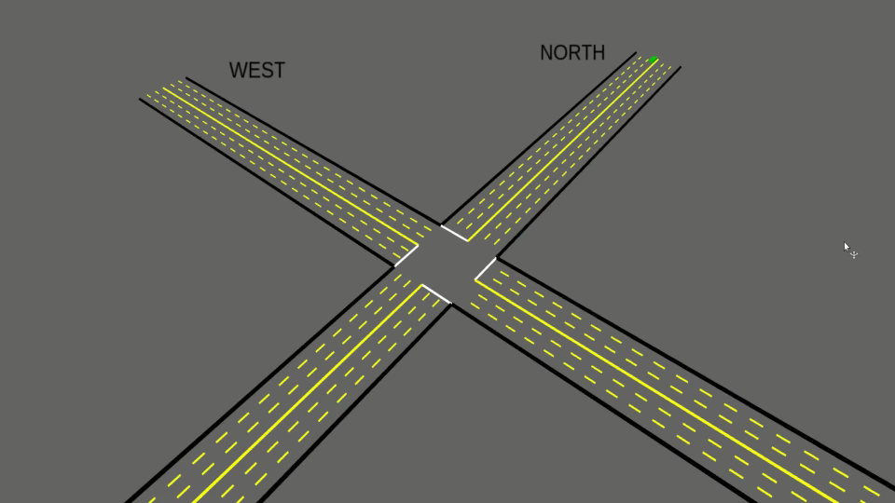
Our Policy

Slide 4
Challenges & Time Crunch
Developing a stress testing technique (on hold)
ACC was too simple
RVIZ
Not being able to accurately display Tesla stl file
Small edge cases cause undesirable behavior

Slide 5
Collision Avoidance Policy
Try trajectory with desired velocity
Identify point of collision
Slow down or speed up car
Try new trajectory
Try opposite speed
Return success or failure

Slide 6
Measures of Success
Comparing efficiency (delay) between different modes
Traffic Lights
Stops Signs
Dresner & Stone’s policy
Our policy
Our policy should at least provide shorter delays than current Traffic Light and Stop sign systems
Stretch goal: Shorter delay than Dresner & Stone’s policy

Slide 7
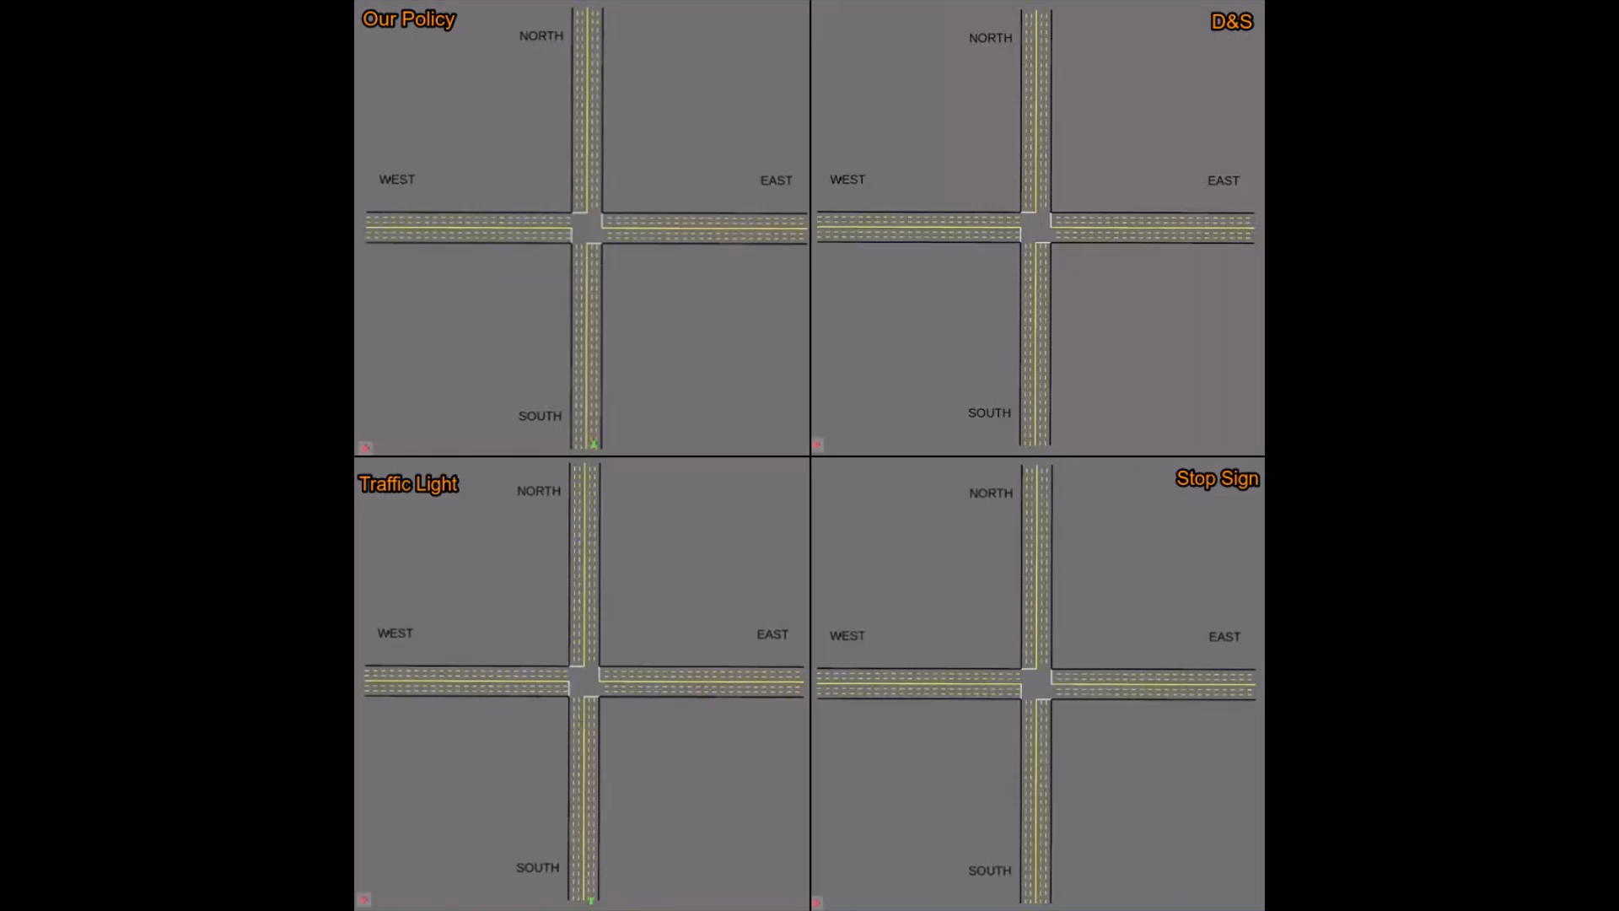

Slide 8
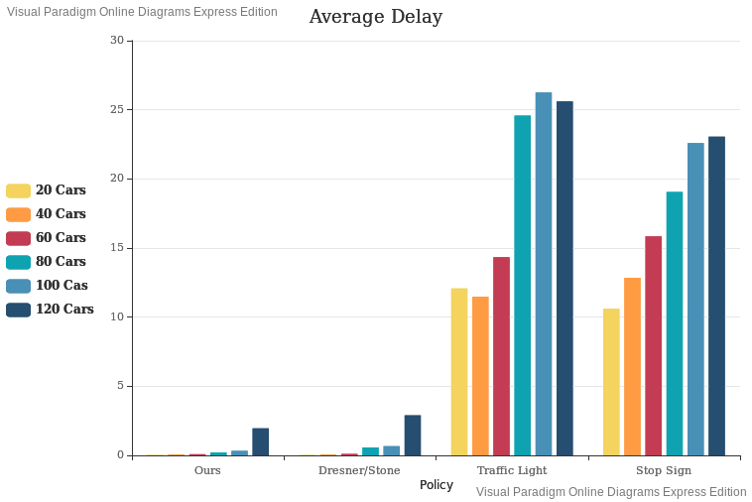
Policy | 20 cars/ 20 sec | 40 cars/ 20 sec | 60 cars/ 20 sec | 80 cars/ 20 sec | 100 cars/ 20 sec | 120 cars/ 20 sec
Ours | 0.031 | 0.068 | 0.084 | 0.206 | 0.326 | 1.957
Dresner/Stone | 0.026 | 0.057 | 0.105 | 0.575 | 0.667 | 2.898
Traffic Light | 12.078 | 11.485 | 14.336 | 24.584 | 26.250 | 25.607
Stop Sign | 10.610 | 12.849 | 15.846 | 19.062 | 22.582 | 23.050

Slide 9
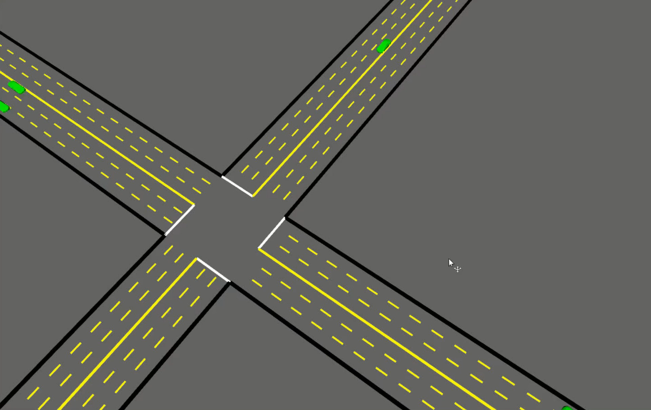
Extra Video w/ Tesla STL (Not Accurate)

